Slide 1
Tree Game UI
Bbiswabasu roy

Slide 2
Expression Evaluation
Given an expression and values of variables, students need to evaluate the expression. We also add an option where students can get a visualization of how the expression gets evaluated using an expression evaluation tree/graph

Slide 3
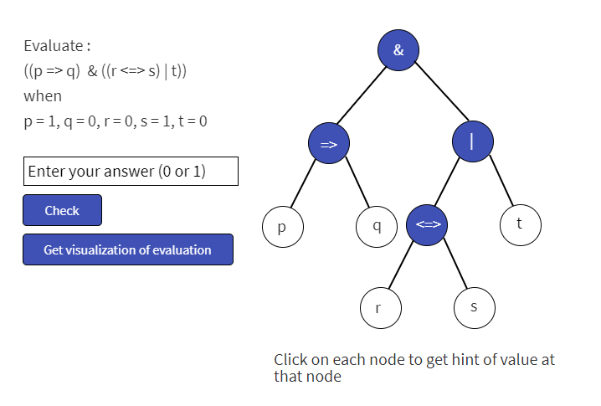

Slide 4










Slide 5
Match Expression with node
Given the structure of the tree and a list of expressions, students match each expression with the correct node of the tree which corresponds to evaluation of that expression

Slide 6
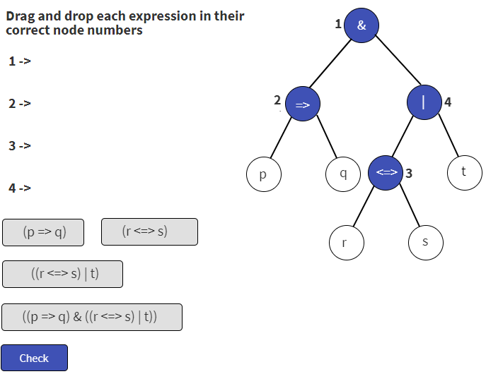

Slide 7
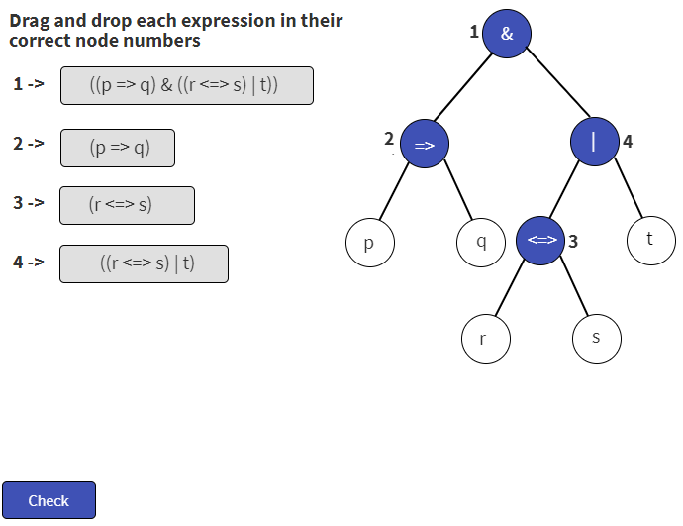

Slide 8
Find missing values and operators
The tree is given but some variables are not yet assigned their values and operators at some nodes are not yet decided. Students assign them correct values/operators so that the expression evaluates as given

Slide 9
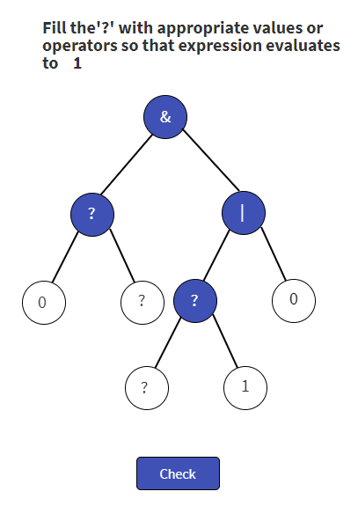
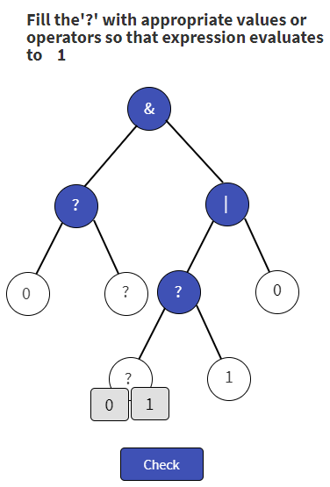
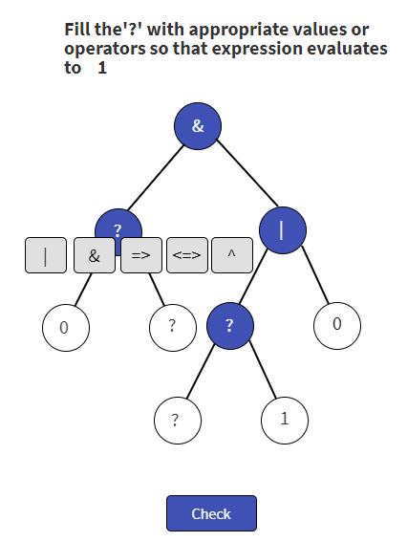

Slide 10
Parameterization
Number of variables – which is equivalent to the number of leaf nodes. By deciding whether some node has children or not, different structures can be generated.
Height of tree – Depending on the proficiency of the student in the associated concepts, we can vary the height of tree. Once we collect data on student’s performance wrt height and proficiency, we can develop some learning algorithm to improve it.
Content of each node – Leaf nodes have 3 states (0,1,null) and non-leaf nodes have some no. of states (operator1, operator2, null). Depending on which game students choose to play we can assign them values. If student chooses “Expression Evaluation” or “Match Expression with nodes”, we fill all nodes with non-null values. If the students chooses to play “Fill missing values” game, we keep some nodes as null. We can try to check for each of the assignments, how many solutions it has and give a configuration having lesser solution to those students who have higher proficiency.
Structure – The structure can either be a tree or a Directed Acyclic Graph (DAG).

Slide 11
Parameterization (contd.)
Displaying complete expression – Some of the games display the complete expression and ask questions while some doesn’t. So, deciding whether to display the expression or not can help in automatic generation of different games

